Slide 1

Fashion Recommendation System
Team:TS-PT-06
Presented By:
2010030007 -Yashwanth
2010030481 - Tejaswini
2010030521 - Eshika
2010030532 –Sai kamal

Slide 2
Abstract
Fast fashion has witnessed tremendous growth in the textile and fashion industries in recent years. E-commerce platforms offer a multitude of options, making an efficient recommendation system critical to sort, order, and convey relevant product content or information to users. Fashion recommendation systems (FRSs) based on images have attracted a lot of attention from fast-fashion retailers since they enable consumers to create a personalized shopping experience. With advances in technology, this branch of artificial intelligence exhibits an incredible amount of potential when it comes to image processing, parsing, classification, and segmentation. Academic articles on this topic are few despite its enormous potential. The available studies do not provide a rigorous review of fashion recommendation systems and the corresponding filtering techniques. Moreover, different potential models are presented here that will be used to develop fashion recommendation systems in the future.

Slide 3
Table of Contents
01
02
03
Introduction
04
Discussion
05
Work collection
literature survey
Dataset Collection
06
Conclusion

Slide 4
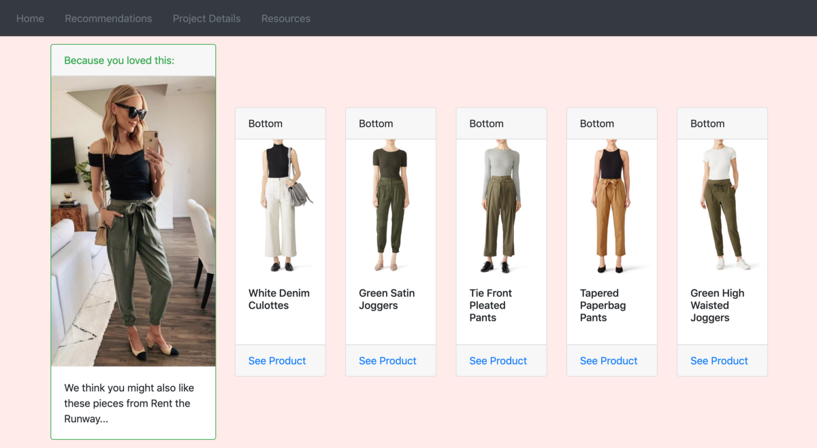
Introduction
Using Machine Learning, to create a fashion recommendation system that works like highly personalized online shopping recommendations. Unlike other areas, fashion recommendations should not be based solely on a customer's taste and past activity. Creating a fashion recommendation system is complicated by many external factors (many of which are emotional). In addition to fashion rules, dress codes, and current trends, one must consider public perceptions.

Slide 5
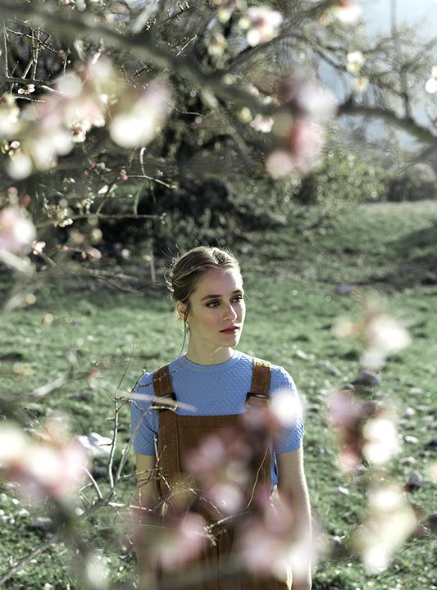
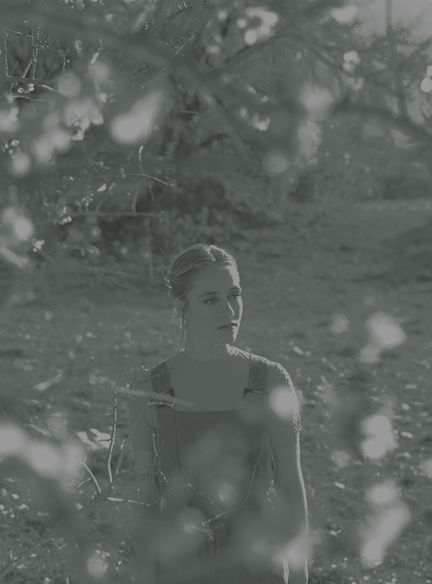
Literature Survey

Slide 6
Research Paper 1
Name : PAI-BPR: Personalized Outfit Recommendation Scheme with Attribute-wise Interpretability
Published : Sagar, Dikshant, Jatin Garg, Prarthana Kansal, Sejal Bhalla, Rajiv Ratn Shah, and Yi Yu. "PAI-BPR: Personalized Outfit Recommendation Scheme with Attribute-wise Interpretability." In 2020 IEEE Sixth International Conference on Multimedia Big Data (BigMM), pp. 221-230. IEEE, 2020.
Method :
Attribute Classification Network (ACN)
Text-CNN
Bi-LSTM
Result: In this paper they present an outfit recommendation scheme towards interpretable personalized clothing matching, called PAI-BPR
They were able to successfully identify the prominent attribute pairs in an outfit that make it compatible or incompatible by using our attribute representation model. However, PAI-BPR works only for a pair of tops and bottoms

Slide 7
Research Paper 2
Name: Fashion Recommendation and Compatibility Prediction Using Relational Network
Published: Moosaei, Maryam, Yusan Lin, and Hao Yang. "Fashion Recommendation and Compatibility Prediction Using Relational Network." arXiv preprint arXiv:2005.06584 (2020).
Method :
CNN
Bi-LSTM + VSE
BPR-DAE
RAW-V
FashionR
Result: The authors proposed a method of determining fashion compatibility in this paper. Based on the idea that an outfit was a scene and its items were objects in the scene, FashionRN and FashionRN-VSE were developed to learn the visual relations between items in order to determine their compatibility with each other. their model showed state-of-the-art performance in both compatibility prediction tasks and fill-in-the-blank tests. Apart from their ability to perform the above prediction tasks, FashionRN and FashionRN-VSE are also able to learn item and outfit embeddings that carry underlying compatibility.

Slide 8
Research Paper 3
Name: Hierarchical Fashion Graph Network for Personalized Outfit Recommendation
Published: Li, Xingchen, Xiang Wang, Xiangnan He, Long Chen, Jun Xiao, and Tat-Seng Chua. "Hierarchical fashion graph network for personalized outfit recommendation." In Proceedings of the 43rd International ACM SIGIR Conference on Research and Development in Information Retrieval, pp. 159-168. 2020.
Method :
VBPR,
HFGN,
Bi-LSTM,
Result: In this paper, Hierarchical Fashion Neural Network (HFGN), to solve the task of personalized outfit recommendation, which requires the recommended targets not only to have nice compatibility but also meet user’s personal taste. HFGN Benefiting from the graph structure and message propagation across items, HFGN is capable of modeling complex interactions among items within the same outfit.

Slide 9
Research Paper 4
Name: Single-Item Fashion Recommender: Towards Cross-Domain Recommendations
Published: Mohammadi, Seyed Omid, Hossein Bodaghi, and Ahmad Kalhor. "Single-Item Fashion Recommender: Towards Cross-Domain Recommendations." arXiv preprint arXiv:2111.00758 (2021).
Method :
Intersection over Union IOU.
fine-tuned ResNet50 paralleled with a shallow net and a personalizer network on top.
objective-guided human score(OHS)
Result: This article provided a single-item content-based fashion recommender for in-shop search and recommendation by training a convolutional neural network consisting of double branches, a deep ResNet50 network, and the other one a shallow net. Then, it used this network as a feature extractor in a two-stage structure to form personalized recommendations. Next, a background augmentation method was proposed to enable the system to make cross-domain suggestions. Finally, this work introduced objective-guided human score, an evaluation metric for recommendation tasks, a customizable framework that turns subjective evaluations into interpretable and comparable percentage values. The comparison results showed that EfficientNets could be superior to ResNets for the task at hand.

Slide 10
Dataset Collection
1.Fashion 144K:Fashion144k dataset consisting of 144,169 user posts with images and their associated metadata, for predicting fashionability, that is, how fashionable the user and their outfit is in an image.
2. DeepFashion:DeepFashion is a dataset containing around 800K diverse fashion images with their rich annotations (46 categories, 1,000 descriptive attributes, bounding boxes and landmark information) ranging from well-posed product images to real-world-like consumer photos.
3. Polyvore (Polyvore Outfits):This dataset contains 21,889 outfits from polyvore.com, in which 17,316 are for training, 1,497 for validation and 3,076 for testing
4. POG(Personalized Outfit Generation):POG is the only available large-scale dataset that meets our requirements. The dataset collects click actions from 3.57 million users, including 1.01 million outfits and 583 thousand individual items with context information.
5. Amazon Fashion dataset:This is a pre-crawled dataset, taken as subset of a bigger dataset (more than 7 million fashion products) that was created by extracting data from Amazon.

Slide 11
Discussion
After studying different research papers we found that every research followed different methods and techniques so will try to adapt the best model to get accurate and good results

Slide 12
Work Allocation
Name | Work done
Manne Tejaswini Sai Gayathri | Research paper 1: PAI-BPR: Personalized Outfit Recommendation Scheme with Attribute-wise Interpretability
Sai Kamal | Research paper 2: Fashion Recommendation and Compatibility Prediction Using Relational Network
Eshika Sanjana | Research paper 3: Hierarchical Fashion Graph Network for Personalized Outfit Recommendation
Alluri Yashwanth | Research paper 4: Single-Item Fashion Recommender: Towards Cross-Domain Recommendations

Slide 13

Conclusion
A recommendation system can open up new opportunities for retailers by enabling them to provide consumers with personalized recommendations based on information retrieved from the Internet. They help consumers quickly find products and services that closely match their preferences. Furthermore, a number of state-of-the-art algorithms have been developed to recommend products based on users' interactions with their social groups. Therefore, social media images are increasingly being embedded within fashion recommendation systems. This document presented a review of the fashion recommendation systems, algorithmic models, and filtering techniques presented in academic articles related to this topic.

Slide 14
Thank You

